Slide 1
Combating ML and Evolving Role of Professionals.
ADV. (CA) SHIKHAR GARG
M.COM, LLB, CA, CPA (USA).
Mobile - 9013265820
Email - cashikhargarg@gmail.com

Slide 2
What is PMLA
Prevention of Money Laundering Act, 2002.
Prohibits earning money from criminal activity.
Sec. 2(1)(y) - Predicate Offence
Notes:
Finance Act 2019. (difference of OR).
Predicate offence - Schedule offence.

Slide 3
Applicability of PMLA (Section 1)
The Act extends to whole of India w.e.f. 17 January 2003 (No exclusion for State of J&K).
Section 1(3), provides for deferred legislature. Hence, The central government notified the date of applicability as 1 July 2005.
As per A.K. Roy vs UOI (SC) (1 SCC 271) - Deferred enforcement clauses are legitimate where executive preparedness is necessary for Act implementation.
Notes:
Section 1(3) of GST 22.06.2017, 01.07.2017.
Section 9(2) - Petroluem products.
Section 51 - TDS
Section 52 - E commerce (TCS collections). (1 years after formulation).
Income Tax.
Section 151A of the FAO vs JAO.

Slide 4
Exexutive Preparedness
Financial Intelligence Unit - India (FIU-IND) under the department of revenue.
Identify predicate offences. (different from Scheduled offence)
Appointment of officer of ED as authorities, under section 48 of the Act. (Under Minister of Finance).

Slide 5
Objectives of Prevention of Money Laundering
1. Prevent and control money laundering activities.
2. Confiscate and attach the proceeds of crime.
3. Punish those who attempt to legitimate tainted money though financial system.
4. Restore/repatriate the money back to the victims.
Notes:
Why the PMLA is necessary - terror financing and NDPS cases.

Slide 6
Directorate of Enforcement (ED) - Under MOF
ED was formed in 1st May 1956 under the FERA, 1947 which become FERA, 1973 and later was succeeded by FEMA, 2000.
Further governed the adjudication of PMLA, 2002 and FEO, 2018.
It is India’s premier financial investigation agencies, which specialize in tracing the proceeds of crime involved in the criminal activity.
Notes:
Financial activity are done with cool calculations and not with the heat of moment. Action done in heat of the moment are easier for investigation agencies. (Police or CBI).

Slide 7
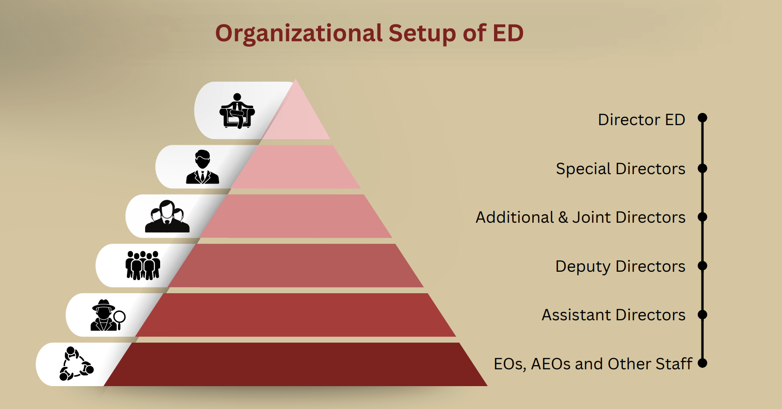
Organization set up
Director ED
Special Directors (5 person).
Additional & Joint Directors.
Deputy Directors.
Assistant Directors.
Other staff.
In 2011, the staff increased
from 745 to 2063. Currently, in 2025, its
strength is 2030.
Presently ED is organised into 5 regions,
27 Zones and 18 Sub-Zones.
Notes:
ED director - Rahul Navin, IRS 1993 Batch.

Slide 8
As per the Annual Report of Enforcement Directorate till 31.03.2025
S.No. | Particulars | Amount (in Rs. Cr)
1 | Attachment | 1,54,594
2 | Affirmed by adjudication | 1,06,730
3 | Restitution of proceeds to victims - Section 8(8) (Also from FEO Act, 2018). Restore to the claiminant who has legitimate interest and has suffered loss due to the money laundering activity. | 30,482

Slide 9
Attachment in Corruption cases

Slide 10
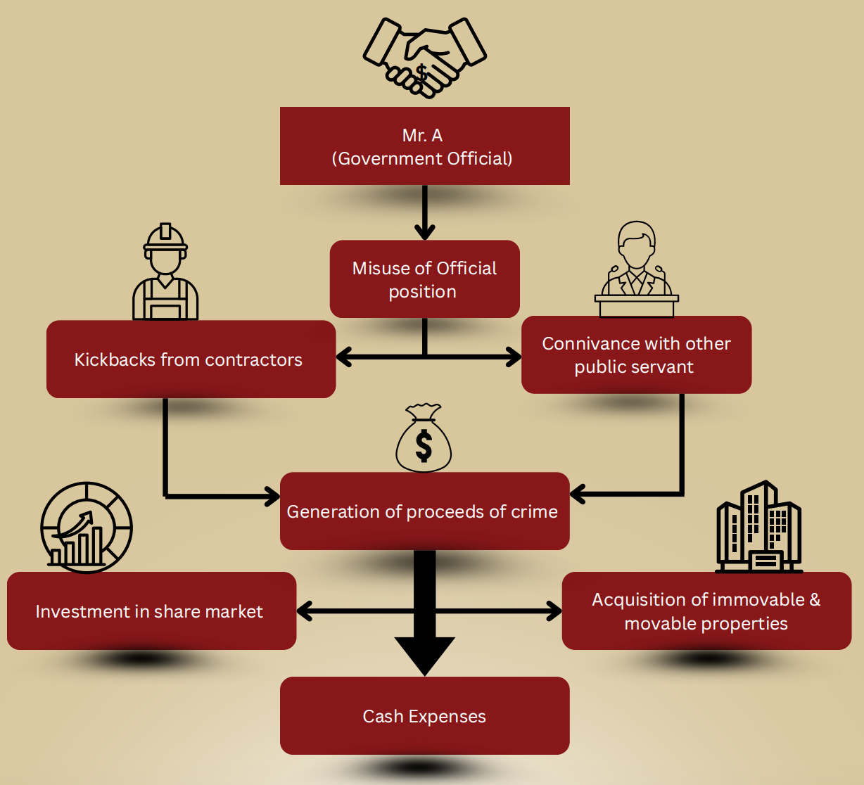
Govt. official case in Bihar
Mr. A is a senior official in central govt. deputed in Bihar govt. During his tenure, 90 crores of PUC was amassed primarily via kickbacks from contractors.
That amount was invested in share market and immovable property.
ED prosecuted conducted search at more than 70 places. ED arrested 11 individuals, attach property worth 24 crores apart from cash and luxury watches.

Slide 11
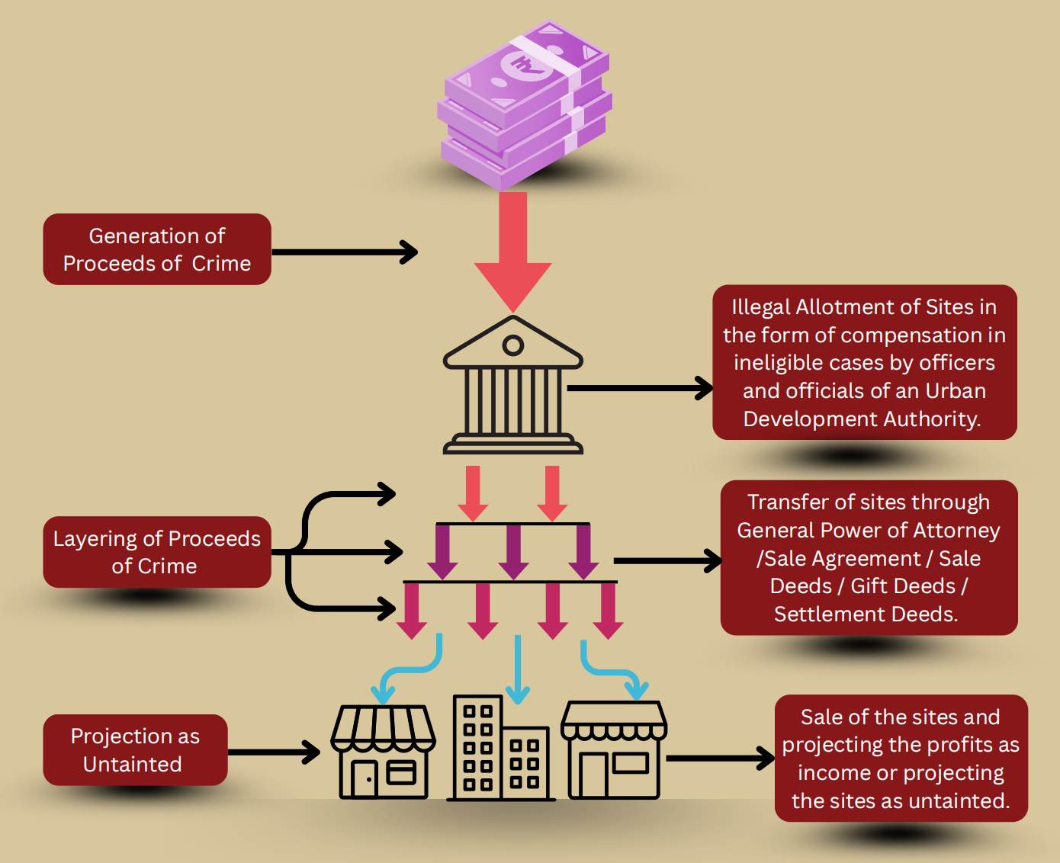
MUDA case
Cases initiated by illegal allotment of sites by the officers
of Mysore urban development authority. (MUDA).
Investigation revealed that a total of 1045 sites having
market value of 700 crores was illegally alloted in
contravention of statutory guildlines.
Deep rooted nexus with sites allotment with estate
business were found. Illegal gratification was generated
in cash. Such PUC was layers via gift deed via
sham GOP and projecting the profits as income.
ED attached 82 sites worth more than 300 crores.

Slide 12
Few examples of Restitution Cases

Slide 13
SRS Group Case
SRS Group led by chairman and managing director Anil Jindal cheated thousands of investors. The Group took loans from them and siphoned off the funds in shell companies. No formal agreement was made, unsigned receipts were issued.
The ED attached worth thousands of crores of assets in the name of the directors of the group. The Hon’ble Tribunal verified the hundreds of claims of the hombuyers. 78 genuine cases were identified. The Tribunal approved the released to 20 flats in the name of SRS group worth 20 crores to the claim buyers.

Slide 14
Rose Valley Chit Fund scam
It is one of the largest financial fraud in India, thousands of investors were defrauded. The defrauded investors filed a petition at Calcutta High Court for restitution of funds attached by ED. High Court constituted an Asset Disposal Committee (ADC) for redresal of fraud.
More than 31 lakhs claim where submitted to ADC, as on 31.03.2015, more than 1.5 lakhs investors have been restored the claims of over 538 crores.

Slide 15
Gitanjali Gems Fraud
Mehul Choksi, a businessman involved in manufacturing and export of gold and diamond through Gitanjali group of companies started into criminal consipiracy with the bank officials of PNB. They dupped letters of undertaking and foreign letters of credit amounting to thosuands of crore. The said funds were subsequently siphoned off to his foreign entity in guise of the payment of imports.
The ED attached assets worth Rs. 2,565 crores and the special court allowed the claims fo Rs. 2,565 filed by PNB and ICICI Bank.

Slide 16
Proceeds of Crime - Section 2(1)(u)
Any property derived directly or indirectly from a person as a result of criminal activity relating to a predicate offence.
It includes value taken aboard in relation to the predicate offence.
Notes:
Making is extraterritorial provision. (Wide view is affirmed by vijay madanlal choudary (2022)).

Slide 17
Offence of Money Laundering - Section 3
Whosoever directly or indirectly attempts to indulge or knowingly assists or knowingly is a party or is actually involved in any process or activity connected with the proceeds of crime, including its concealment, possession, acquisition, use and projecting or claiming it as untainted property shall be guilty of the offence of money-laundering.
It is drafted very wide and inclusive langauge to capture the entire chain of laundering activity. (From originator to persons assisting are covered). Even, professionals facilitating concealment or projection can be culpable.
Notes:
The term “knowlingly” is a key, absence of mens rea distinguishs negligence from complicity.
Income tax (chapter 22 governs section 275A to 280D). Willful attempt to evade tax, making false statement in verification. GST - section 132 of CGST act. Supply of goods/service without invoice, issuing invoice without supply leading to wrongful ITC. Availing ITC using fake invoice.

Slide 18
Schedule Offence - Section 2(y)
Schedule A Offence - Offences from 29 Acts
Eg- 364A IPC, 302 IPC, 255 (conterfeiting govt. stamp), NDPS Act. PC Act, Sec. 135 of custom act (duty evasion). SEBI Act, UAPA, Wildlife Act offences.
Schedule B Offence - If the total value of such offence exceeds 1 crores. Section 132 of Customs Act, 1962 - False documents under Customs Act.
Schedule C Offence - Offences having cross border implications and offences in Black Money Act, 2015
Notes:
SEBI Act- Insider trader information. Wildlife (Elephant tusk trading, ivory trading).

Slide 19
Punishment of Money Laundering - Section 4
Whosoever commit a crime of money laundering under part -A, B, & C shall be punishable with rigorious imprisonment of not less than 3 years but may be extended upto 7 years.
For offence under NDPS Act, the period of imprisonment is upto 10 years.

Slide 20
Financial Action Task Force - FATF
Incorporated in 1989 as intergovenmental policy making bodies.
It aims to prevent money laundering, terrorist financing and proliferation of weapons of mass destruction.
India became the member of FATF in 2009.
At present, FATF is having more than 200 countries association or the standard set by it.
On site evalution of the FATF happened in 6th November - 24th November 2023. The Places its resulting report in september 2024 placing india in the “regular follow-up” category.

Slide 21
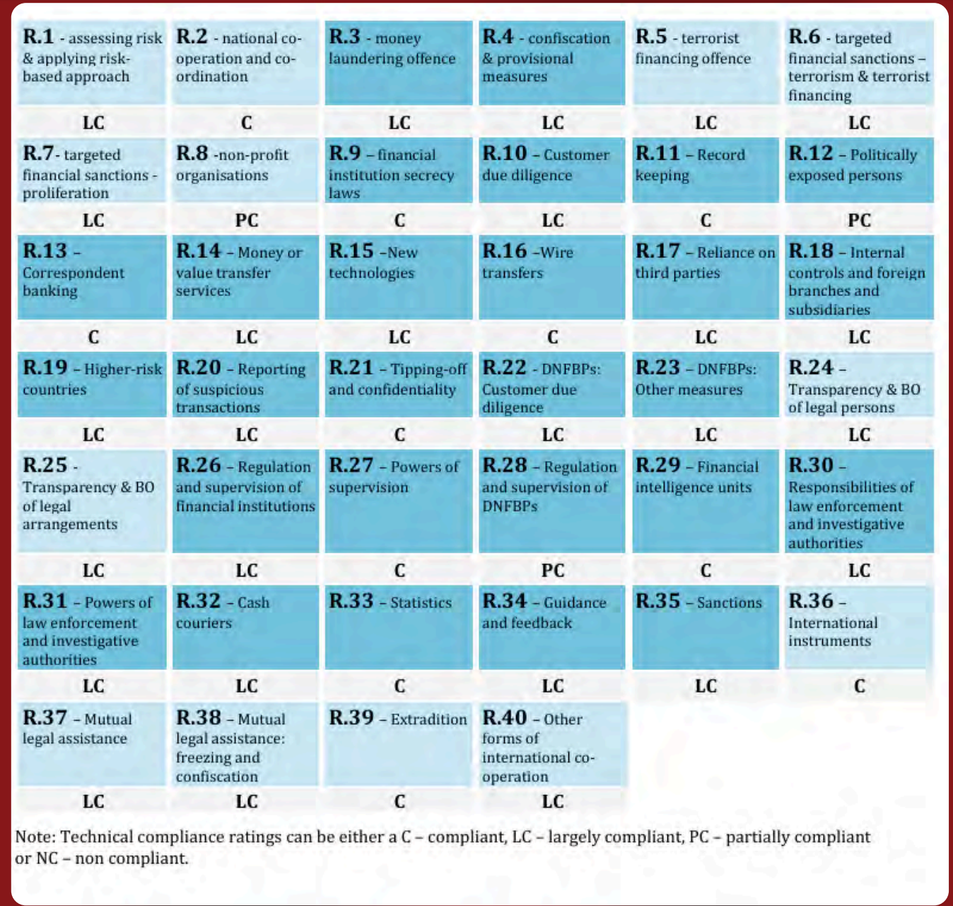
Mutual Evaluation Process - MEP

Slide 22
Shortcoming in the FATF Report
NPO sector is prone to terror funding. (Regulation 8). Data driven approach to terror-financing detection.
Investigation is less focusing on drug and human trafficking. Heavy focus is there on fraud.
Expedite trials- Large backlog of pending money laundering cases.
Enhanced supervision on Designated non- financial businesses and professional.

Slide 23
Reporting entity - Section 2(1)(wa)
(a) Banking companies (Sec 2(e)) - schedule bank, cooperative bank, payment bank, any bank to which banking regulation act 1949 applies.
(b) Financial institution (Section 2(i)) - NBFC, Housing companies, chit funds, mutual benefits companies. As per section 45I of RBI act.
(c) Intermediary (Section 2(n))- Stock brokers, mutual funds distributors, portfolio managers, investment advisors, registered under section 12 of SEBI Act.
(d) Person carrying on a designated business or profession(Section 2(sa)) - casino, real estate agent, jewellery, (other activity as specified as time to time).

Slide 24
Obligation of Reporting entity - Sec 11A to 15
Section 11A : Reporting entity shall verify the entity of its clients. (Aadhaar is valid source of authentication)
Section 12 : Reporting entity shall maintain records with respect to the transaction with his client. (For 5 years)
Section 12AA : Every reporting entity shall take additional steps to examine the ownership and financial position, including the sources of funds of the client. The purpose of transaction is to be recorded.
Section 13 : Reporting entity shall furnish the suspicious transactions to the Financial intelligence unit (FIU-India) or ED. It shall be kept confidential.
Section 14 : Reporting entity is saved from civil and criminal cases against the furnishing of suspicious entity.
Director FIU- INDIA may impose a penalty of Rs. 10,000 to Rs. 1,00,000 for each such failure.

Slide 25
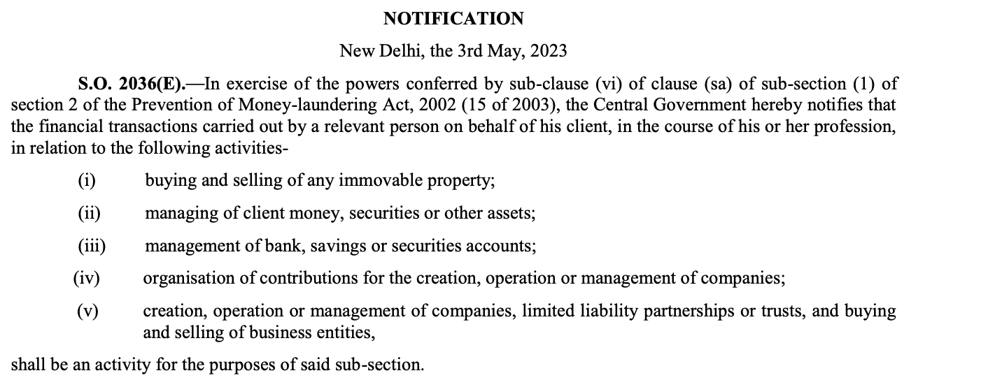
Notification no. 3rd May 2023.

Slide 26
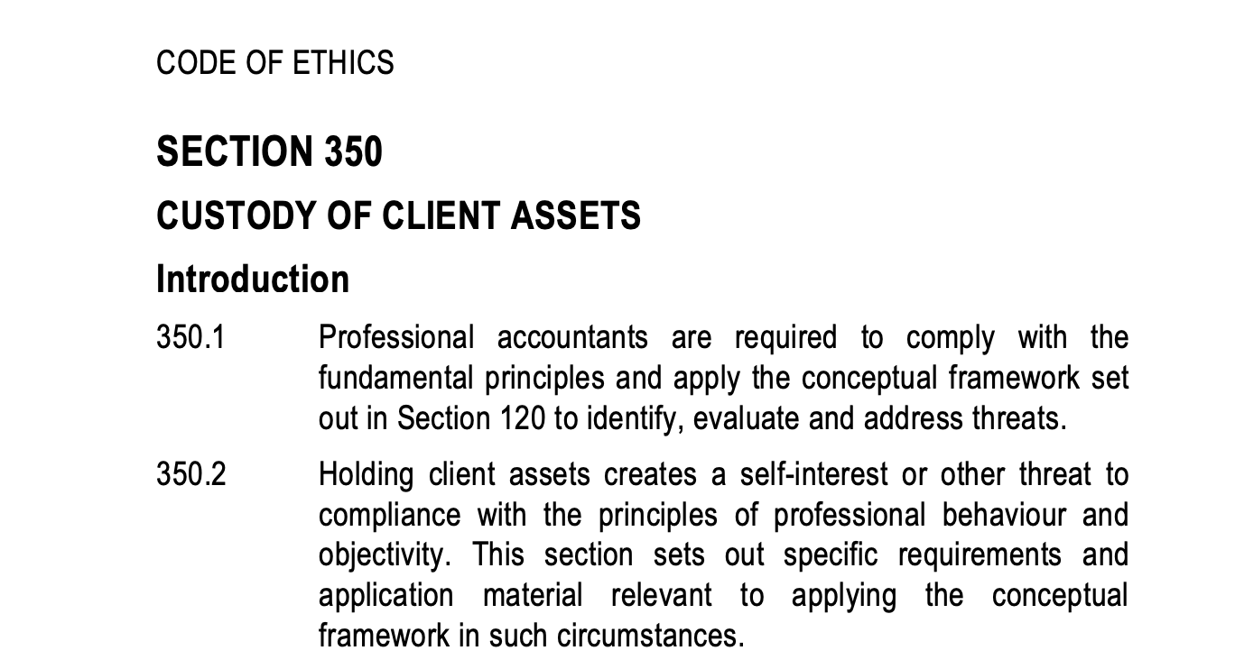
Section 350 - Revised Code of ethics
Custody of client assets is not
permitted due to self review threat.
Clause (a) & (b) are already out of
the scope by code of ethics.

Slide 27
PMLA (Maintenance of Records Rules), 2005
Rule 3 -
All cash transactions above 10 lakhs.
All cash transaction which were forged.
All transaction involving the NPO above 10 lakhs.
All suspicous transaction (Rule 2(g))
Rule 7 - Information furnished to FIU- INDIA. (Financial Intelligence Unit- INDIA).
Rule 8 - Period of furnishing the information - 15th of suceeding month
STR - within 7 days of forming suspicion.
Reporting suspicious activity is not a breach of client confidentiality (Sec 14.) - Saving clause.
Notes:
Meaning of the suspicious transactions.
The transaction involves proceeds of crime, or
The funds appear to be derived from illegal activity, or
The transaction has no apparent economic or lawful purpose, or
It is structured to avoid reporting thresholds.

Slide 28
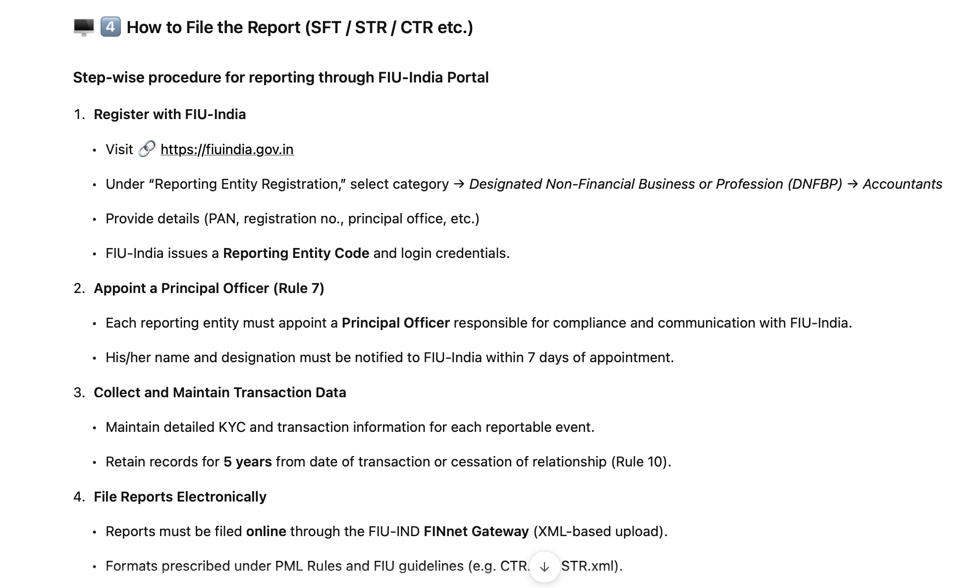
How to file the SFT/STR/CTR
Notes:
SFT- Specified financial transaction.
STR- Suspicious transaction report.
CTR- Cash transaction report.

Slide 29
DNFBP Supervision
Low suspicous transaction reporting (STR) by DNFBP indicates limited awareness and fear amongst them.
Risk mitigation in certain DNFBPs, (Dealers in precious metals & stones) is weak. Simply prohibition on cash transaction is not sufficiently mitigating the risks.
There is limited qualitative and quantitative data on ML/TF risks in DNFBP.
Notes:
Section 269SS and 269T and 269ST is not enough.

Slide 30
What does FIU- INDIA need to do
Arrange training sessions and awareness compaigns of DNFPBs.
Enhance collection of data and analytics regarding transaction volumes, types of transactions, cash usage, complaince history.
Issue guildlines and red flags indicators tailored to specific DNFBP Sectors, so they can better detect suspicious activity.

Slide 31
Interplay of PMLA with Income tax/GST
PMLA operated in coordinated manner with other fiscal statues. - Income tax act and GST laws.
Information from Income tax search (Sec. 132) or reassessment (147/148) can be shared with ED under Section 66(2) of the Act.
Vijay Madanlal Choudhary v. UOI (2022 SC): PMLA proceedings are valid even if income-tax proceedings are pending, provided there is material suggesting laundering of “proceeds of crime.”
Notes:
There is no predicate offence with respect to Income tax and GST laws, therefore, PMLA may run parallel to tax or GST proceedings, having independent jurisdiction.

Slide 32
Prakash Industries Ltd. v. ED (Delhi HC 2023): Parallel investigations permissible; findings of AO not binding on ED.
Similarly in GST, section 132 Offences (fake Invoices offence, wrongful ITC, refund fraud) is not included in the PMLA schedule.
GST Investigation: DGGI or State GST detects fake invoices / non-existent firms.
Sanjay Agrawal v. ED (MP HC 2023) : ED can proceed even before GST adjudication concludes.

Slide 33
GST case turns into PMLA proceedings
Illustration: Fake Invoicing Case with Forgery Elements
DGGI Search:
M/s. Alpha Traders found issuing fake GST invoices worth ₹8 crore without supply of goods — availing ineligible ITC and refund.
Offences under Section 132(1)(b)&(c), CGST Act detected.
Discovery of Forgery:
Investigation revealed forged PAN, Aadhaar, and bank documents used to open accounts and claim refunds.
Offences under IPC 467, 471 (forgery & use of forged documents) — these are scheduled offences under PMLA.
Notes:
Circular trading happening.

Slide 34
ED Action:
Based on DGGI’s report, ED registered ECIR under Section 3 of PMLA for laundering of “proceeds of crime.”
Funds were routed through shell firms and used to acquire assets.
Properties worth ₹5.2 crore attached under Section 5(1) PMLA.
Judicial View:
Courts (Anil Kumar v. ED, Delhi HC 2022) upheld that if forgery/cheating accompanies GST fraud, ED can proceed under PMLA even though the GST Act itself isn’t in the Schedule.

Slide 35
PMLA Coverage in Slides.
Chapter | Section. | Heading.
I | 1-2 | Preliminary.
II | 3-4 | Offence of Money Laundering.
III | 5-11 | Attachment, Adjudication and confiscation.
IV | 11A - 15. | Obligation of reporting entities.
V | 16-24. | Summon, search and seizures.
VI | 25-42. | Appellant Tribunal
VII | 43-47. | Special Courts.
VIII | 48-54. | Authorities
IX | 55-61. | Reciprocal assistance.
X | 62-75. | Miscelleneous.

Slide 36
Any Queries ?
Contact details.
ADV. (CA) SHIKHAR GARG
M.COM, LLB, CA, CPA (USA).
Mobile - 9013265820
Email - cashikhargarg@gmail.com

Slide 37


